Slide 1
Community Led Economic Development in the United States: How the Community Capital Framework Encourages Sustainable Approaches

Slide 2
Helping Communities Shine!

Slide 3
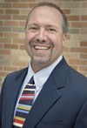
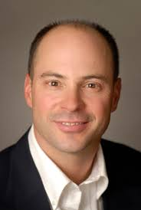
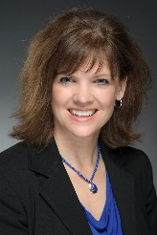
Instructors
Greg Wise
Professor and Community Development Specialist
University of Wisconsin-Extension
Center for Community and Economic Development
(608) 263-7804 greg.wise@uwex.edu
Paul Lachapelle
Community Development Specialist
Montana State University Extension
406-994-3620 paul.lachapelle@montana.edu
Jane Wolery
Extension Agent/Field Faculty
Montana State University Extension
406-466-2492 jane.wolery@montana.edu

Slide 4
Instructors
Greg Wise
Professor and Community Development Specialist
University of Wisconsin-Extension
Center for Community and Economic Development
(608) 263-7804 greg.wise@uwex.edu
Paul Lachapelle
Community Development Specialist
Montana State University Extension
406-994-3620 paul.lachapelle@montana.edu
Jane Wolery
Extension Agent/Field Faculty
Montana State University Extension
406-466-2492 jane.wolery@montana.edu
Notes:
We can decide which slide we like better. I’m waiting for a different logo from MSU that might be more comparable and balance better.

Slide 5
Essential Elements
A changing Paradigm for Genuine Community Engagement and Sustainable Development
Of Community Development in the United States
Greg Wise
Regional … Collaborative … Empowering … Holistic & Sustainable

Slide 6
Values and Ethics Driven Practice
Promote active and representative participation toward enabling all community members to meaningfully influence the decisions that affect their lives.
Greg Wise
CDS Principles of Good Practice

Slide 7
Values and Ethics Driven Practice
Engage community members in learning about and understanding community issues, and the economic, social, environmental, political, psychological and other impacts associated with alternative courses of action.
Greg Wise
CDS Principles of Good Practice

Slide 8
Values and Ethics Driven Practice
Incorporate the diverse interests of cultures of the community in the community development process; and disengage from support of any effort that is likely to adversely affect the disadvantaged members of the community.
Greg Wise
CDS Principles of Good Practice

Slide 9
Values and Ethics Driven Practice
Work actively to enhance the leadership capacity of community members, leaders, and groups within the community.
Greg Wise
CDS Principles of Good Practice

Slide 10
Values and Ethics Driven Practice
Be open to using the full range of action strategies to work toward the long-term sustainability and well-being of the community.
Greg Wise
CDS Principles of Good Practice

Slide 11
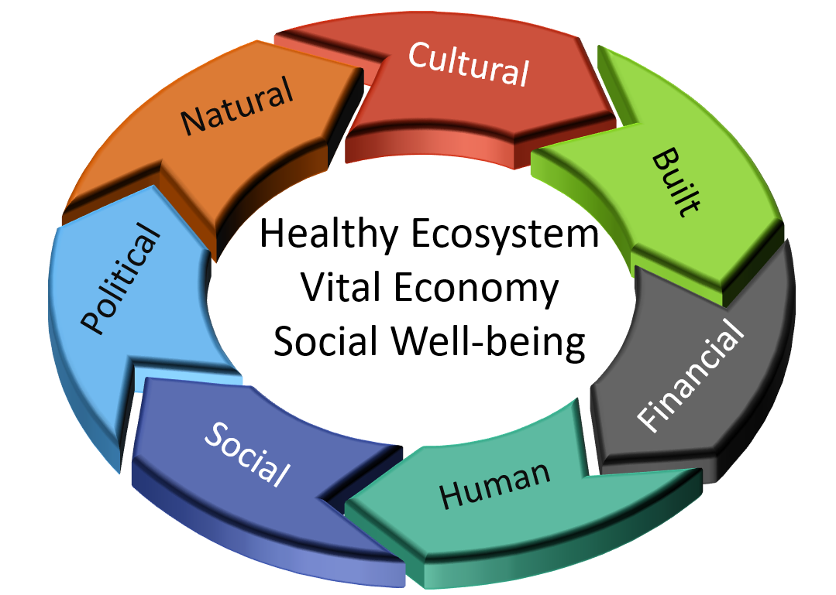
Community Capitals Framework
Shine a Light on Strengths!
Greg Wise

Slide 12
Community Capitals Framework
Shine a Light on Strengths!
Greg Wise

Slide 13
Natural
The environment, natural beauty, lakes, rivers and streams, forests, wildlife, soil, air and the local landscape.
Natural
Greg Wise

Slide 14
Cultural
Ethnicity, generations, stories and traditions, spirituality, habits and heritage.
Natural
Greg Wise

Slide 15
Built
Buildings and infrastructure – schools, roads, water and sewer systems, streets, libraries and other physical community assets.
Natural
Greg Wise

Slide 16
Financial
Money, charitable giving, grants, access to funding and community wealth.
Natural
Greg Wise

Slide 17
Human
The skills and abilities of people, leadership, knowledge and the ability to access resources.
Natural
Greg Wise

Slide 18
Social
Groups, organizations, networks, a sense of belonging, bonds between people – bridging and bonding.
Natural
Greg Wise

Slide 19
Political
Connections to people in power, access to resources, leverage and influence.
Natural
Greg Wise

Slide 20
Sustainability Goals
Keeping the Light Bright!
Greg Wise
UWEX and MSU Extension
support the
Sustainable Development Goals

Slide 21
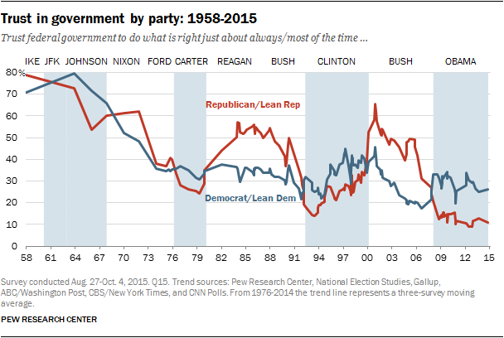
What in the World?
United States Trust in Government by Party
Paul Lachapelle
Source: http://www.people-press.org/2015/11/23/1-trust-in-government-1958-2015/
UWEX and MSU Extension
support the
Sustainable Development Goals

Slide 22
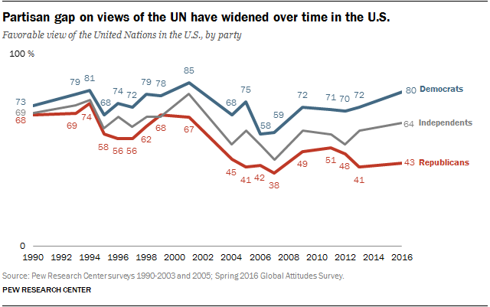
United nations
United States
Paul Lachapelle
Source: http://www.pewresearch.org/fact-tank/2016/09/20/favorable-views-of-the-un-prevail-in-europe-asia-and-u-s/ft_16-09-19_un_3/
UWEX and MSU Extension
support the
Sustainable Development Goals

Slide 23
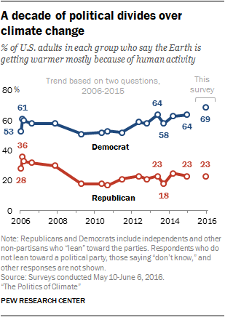
Divides
Paul Lachapelle
Source: http://www.pewinternet.org/2016/10/04/public-views-on-climate-change-and-climate-scientists/
UWEX and MSU Extension
support the
Sustainable Development Goals

Slide 24
Sustainability Goals
How It All Fits Together!
Paul Lachapelle
UWEX and MSU Extension
support the
Sustainable Development Goals

Slide 25
Sustainability Goals
A Closer Look at the Crow Culture …
Paul Lachapelle
UWEX and MSU Extension
support the
Sustainable Development Goals

Slide 26
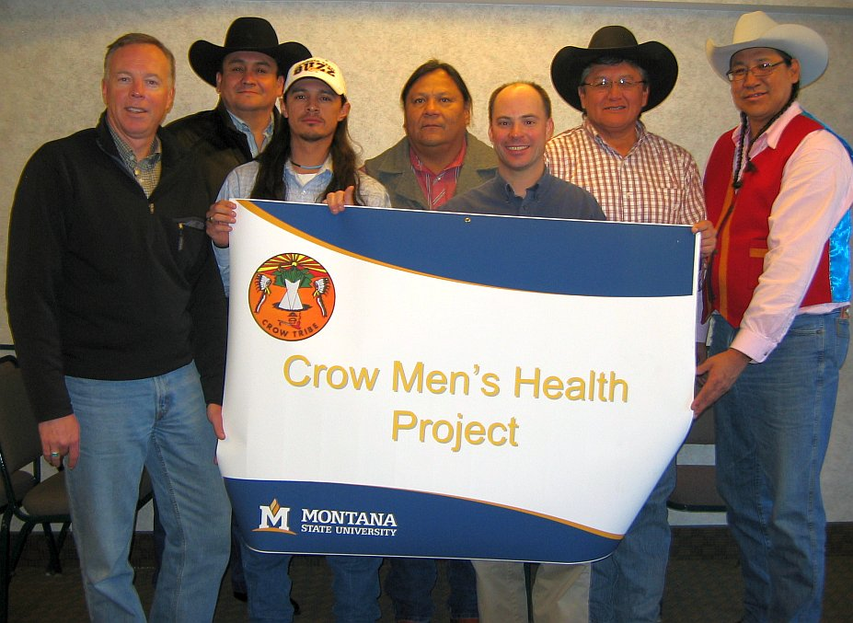
Sustainability Goals
A Closer Look at the Crow Culture …
Paul Lachapelle
UWEX and MSU Extension
support the
Sustainable Development Goals

Slide 27
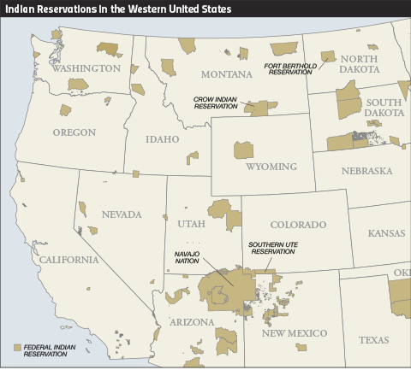
Sustainability Goals
A Closer Look at the Crow Culture …
Paul Lachapelle
UWEX and MSU Extension
support the
Sustainable Development Goals

Slide 28
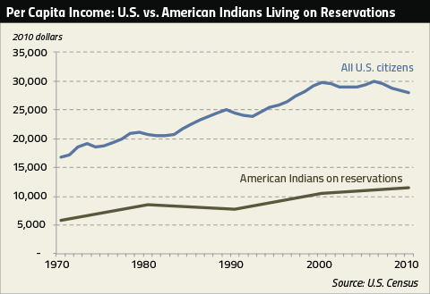
Sustainability Goals
A Closer Look at the Crow Culture …
Paul Lachapelle
Source: http://www.perc.org/articles/unlocking-wealth-indian-nations-overcoming-obstacles-tribal-energy-development
UWEX and MSU Extension
support the
Sustainable Development Goals

Slide 29
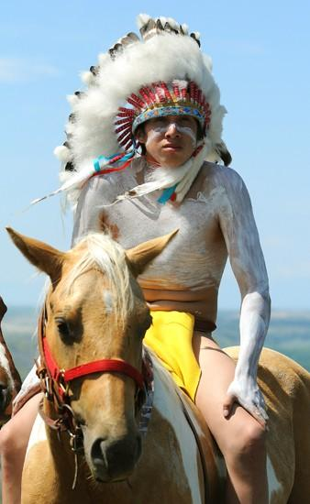
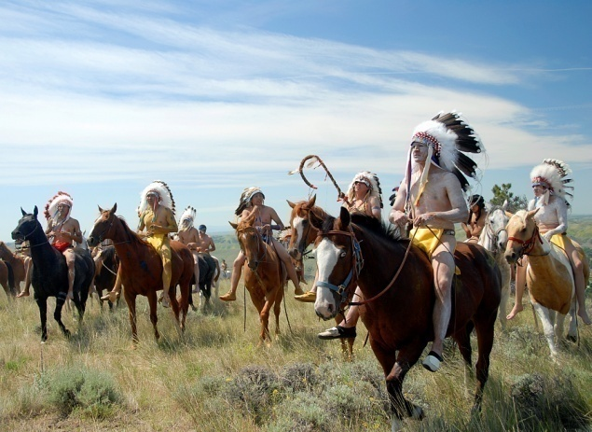
Sustainability Goals
A Closer Look at the Crow Culture …
Paul Lachapelle
UWEX and MSU Extension
support the
Sustainable Development Goals

Slide 30
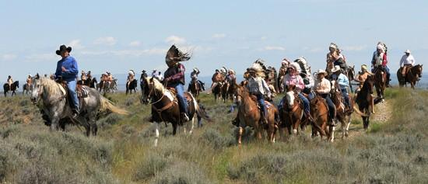
Sustainability Goals
A Closer Look at the Crow Culture …
Paul Lachapelle
UWEX and MSU Extension
support the
Sustainable Development Goals

Slide 31
Understanding community
Teton County, Montana
Jane Wolery
UWEX and MSU Extension
support the
Sustainable Development Goals
Notes:
To understand community development projects, we must first understand the community. Pack your luggage, I’d like to take you on a little trip to the communities I serve.

Slide 32
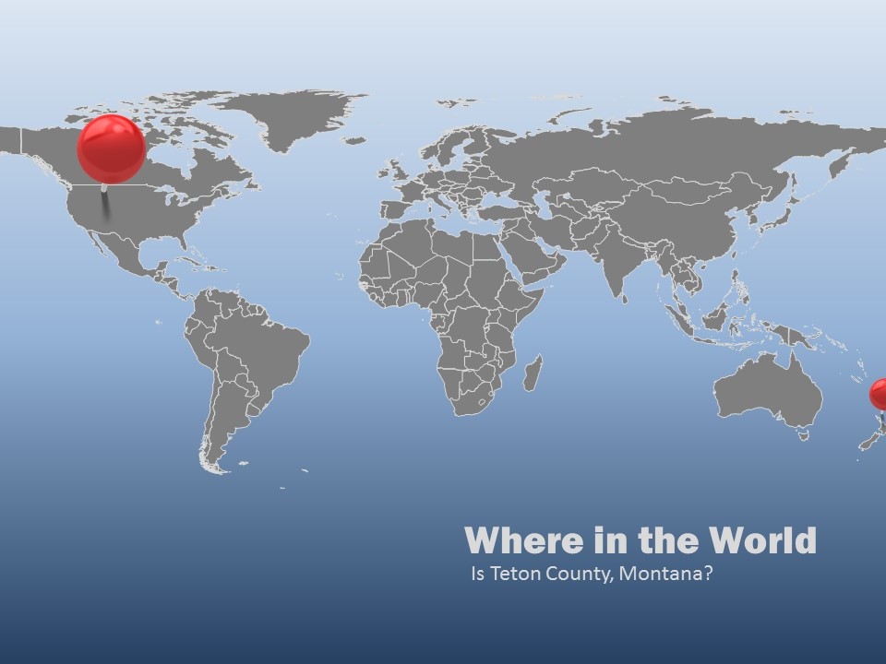
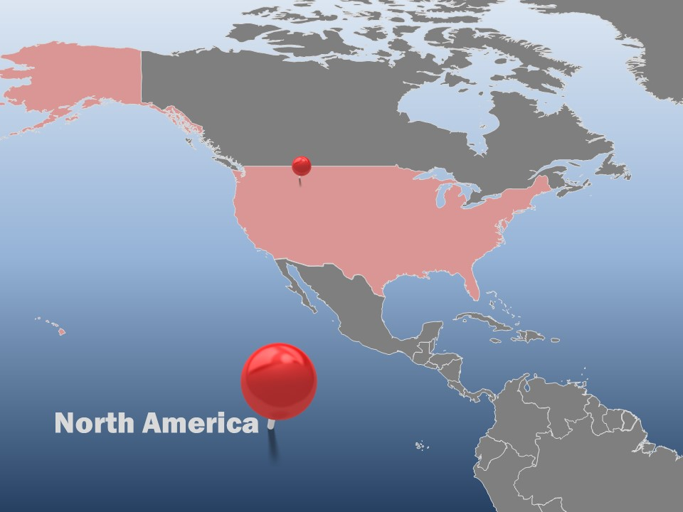
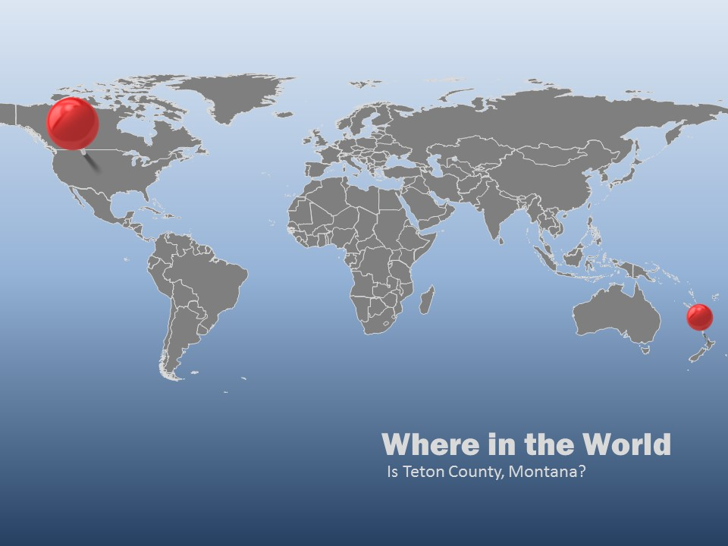
Understanding community
Teton County, Montana
Jane Wolery
UWEX and MSU Extension
support the
Sustainable Development Goals
Notes:
I serve in Teton County Montana … Where in the world is that from here?

Slide 33
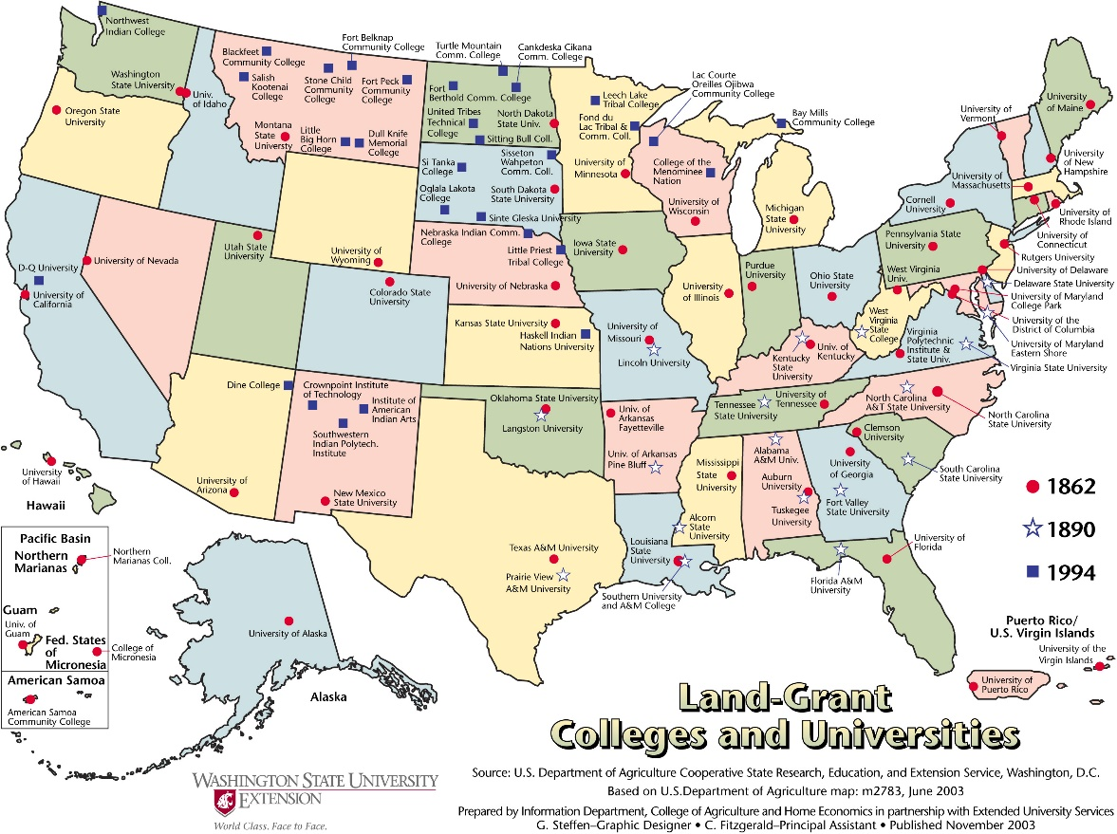
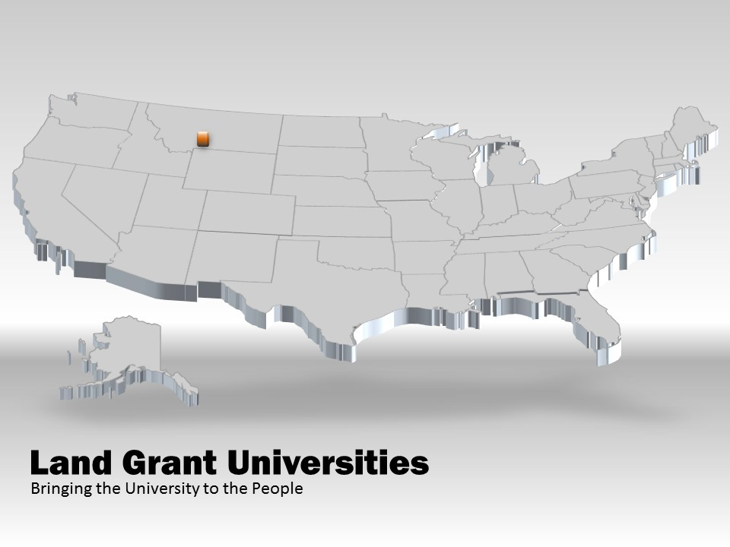
Land Grant Universities
Building Enlightened Citizens
Jane Wolery
UWEX and MSU Extension
support the
Sustainable Development Goals
Notes:
Montana is one of the largest of the United States in terms of land mass. We are connected to the land-grant mission. When we talk about “community development” think of the vision of the leaders of the nation who in 1862, amid considerable turmoil as the Civil War was about to erupt in a debate over slavery, decided that every state in the nation should have a land-grant university that was dedicated to educate the citizenry. Prior to the land-grant university system only the wealthy and privileged were educated at universities.

Slide 34
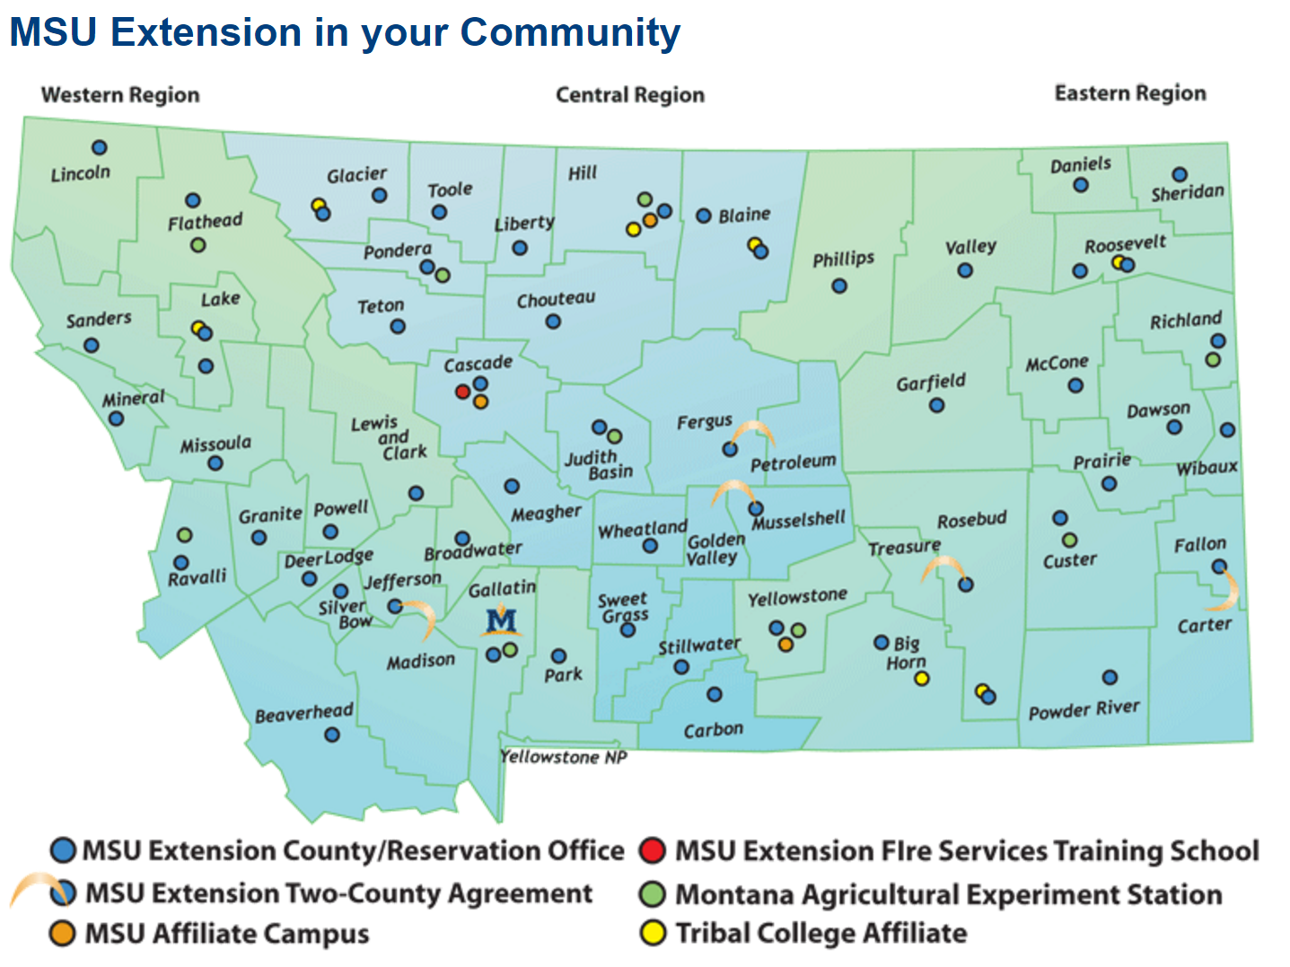
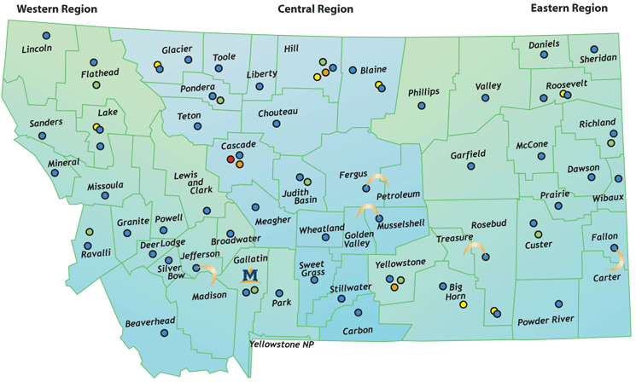
Montana State University
in Every County and Reservation
Jane Wolery
UWEX and MSU Extension
support the
Sustainable Development Goals
Notes:
Eventually that vision for enlightened communities included the Extension Service, which put educators in every county in every state. The goal was and is to bring the best practices based on the research of the universities to the citizens in the county. I am one of the “Extension Agents” or educators for Montana State University. I serve Teton County. Montana is considered a rural frontier state having just a few more than one million people in the land mass of 147,000 square miles. (7 per square mile)

Slide 35
Horizons Program
Taking Dreams from Wishful Thinking to Reality
Leadership Plenty
Study Circles
Action Plans
Outcomes
Jane Wolery
UWEX and MSU Extension
support the
Sustainable Development Goals
Notes:
Teton County is home to several small communities. Our two largest are Choteau and Fairfield. Choteau is the larger community with just 1,700 people. Our community went through an Appreciative Inquiry process in 2008. We were part of the Horizons program to reduce poverty and the affects of poverty in our community. We used Community Capital Framework to determine our community assets and then the Appreciative Inquiry method to define how to work with those strengths and build even brighter dreams. We trained leaders using a curriculum called, Leadership Plenty. We developed Study Circles to identify how to build on our strengths and then came up with action plans.

Slide 36
Appreciative Inquiry
Illuminating the Light!
Discover
Dream
Design
Deliver
Jane Wolery
UWEX and MSU Extension
support the
Sustainable Development Goals
Notes:
The Appreciative Inquiry method is essentially what we used in our communities to discover what we already had for assets, what would make our communities even better – what were the dreams? And, then we set out to design how to get there and Deliver the dream to reality.

Slide 37
Horizons Program
Taking Dreams from Wishful Thinking to Reality
Choteau Community
Opportunities for All Scholarship
Neighbors Helping Neighbors
Community Garden
Community Service School
Jane Wolery
UWEX and MSU Extension
support the
Sustainable Development Goals
Notes:
In Choteau, we developed a program to help those with fewer resources develop their talents through a scholarship program. The Opportunities for All scholarship has assisted youth in taking art, music and swimming lessons. It has helped single parents receive certifications to improve their job prospects. The Neighbors Helping Neighbors has built ramps for low-income citizens who used a wheel chair, provided temporary rent payment assistance and helped fix vehicles for people to get to and from work. The Community Garden group taught people how to grow their own food, but found that a community garden wasn’t feasible and there wasn’t enough interest. A group petitioned the school to include serving the community as one of the requirements for graduation. At the time, the school board voted against the idea, but just this year, the school has come around on the idea on one of their administrators is diligently working to make sure that service is an included component of local education. Sometimes you have to plant an idea and wait for it to grow!

Slide 38
Horizons Program
Taking Dreams from Wishful Thinking to Reality
Fairfield Community
Assisted Living Center
Recruiting Telecommuters
Museum
Walking Trail
Jane Wolery
UWEX and MSU Extension
support the
Sustainable Development Goals
Notes:
Our neighbors in Fairfield watched the process in Choteau and then picked their own action items. The called it their 2020 Vision, because they were deciding what they wanted their community to look like in the year 2020. One of their top concerns was that they had human capital, but those humans were aging. There were no nursing homes or assisted living centers in Fairfield. They wanted to encourage their residents to stay in the community, capitalizing on some of their talents as they aged. Not only did they build an assisted living center, it is full and has a waiting list. The facility is currently adding more space for more residents. One of the residents, who was 94 years young, was routine speaker each year at the elementary school. Fairfield also developed a campaign to draw graduates back to work in their community. They had an all-school reunion and shared video at the event and online with the tagline, “If you can work from anywhere, why not work from home?” They were able to bring a few young couples back home to work. In a town that has fewer than 300 students K-12, adding new young families is significant. Fairfield also had two other projects that have not come to completion.

Slide 39
Honoring the Experience in the Room
Think
Pair
Share
Square
Jane Wolery
UWEX and MSU Extension
support the
Sustainable Development Goals
Notes:
Activity:

Slide 40
Community Capitals Framework
Greg Wise
Shine a Light on Strengths!

Slide 41
On Target for Your Community?
You can add a description of the picture here.
In PPT 2007 or newer, this is a custom layout and can be modified under the slide master view.
Questions? Comments?
Graphics used per subscription with PresenterMedia.com May be used only with subscription.

Slide 42
Instructors
Greg Wise
Professor and Community Development Specialist
University of Wisconsin-Extension
Center for Community and Economic Development
(608) 263-7804 greg.wise@uwex.edu
Paul Lachapelle
Community Development Specialist
Montana State University Extension
406-994-3620 paul.lachapelle@montana.edu
Jane Wolery
Extension Agent/Field Faculty
Montana State University Extension
406-466-2492 jane.wolery@montana.edu

Slide 43
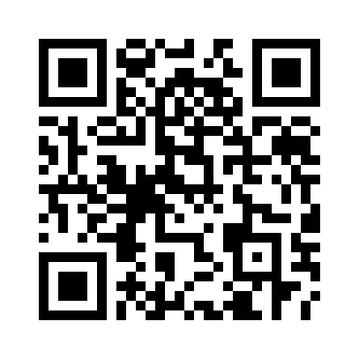
Helping Communities Shine!
Use QR code for more resources used in this presentation.
http://msuextension.org/teton/CommDevelopment.html

Slide 44
Helping Communities Shine!

Slide 45
Useful Images and Icons

Slide 46
Agenda or Summary Layout
A second line of text could go here
Item 1
Discussion Item One – A Placeholder for text Add a second line of text here
Item 2
Discussion Item Two – A Placeholder for text Add a second line of text here
Item 3
Discussion Item Three – A Placeholder for text Add a second line of text here
Item 4
Discussion Item Four – A Placeholder for text Add a second line of text here

Slide 47
Be Sure to Visit Us On-Line
Our website is filled with exciting downloadables, templates, clipart and animations. You can easily switch out the graphics is this template with items from our website.

Slide 48
Bar Graph Page Layout
Here is the description of the graph. This chart is compatible with PowerPoint 97 – 2010.
Here is some more text. You may delete the graphical elements.

Slide 49
Bar Graph Page Layout
Here is the description of the graph. This chart is enhanced with features from PowerPoint 2007 or higher.
Here is some more text. You may delete the graphical elements.

Slide 50
Sample Table Layout
Here is the description of the graph. This chart is compatible with PowerPoint 97 – 2010.
Here is some more text. You may delete the graphical elements.
Geographic Region | Q1 | Q2 | Q3 | Q4
United States | 1254 | 1254 | 1254 | 1254
Europe and Asia | 324 | 324 | 324 | 324
Australia | 32 | 32 | 32 | 32
South America | 2 | 2 | 2 | 2
Canada | 1 | 1 | 1 | 1
Mexico | 1 | 1 | 1 | 1
TOTALS | 1614 | 1614 | 1614 | 1614

Slide 51
Comparison Page
Your Sub Title Here
Your Sub Title Here
This is a place holder for item one. Item one can be text, a picture, graph, table, etc. This is a place holder for item one. Item one can be text, a picture, graph, table, etc.
Change the YOUR LOGO area below by editing the Slide Master under the view tab.
All the graphical elements can be moved, copied, or deleted from the slide master view.

Slide 52
Example Pie Graph
This is a PowerPoint 2007 or higher enhanced graph. You may change this graph as you wish.
This chart utilizes features available in PowerPoint 2007 or higher.

Slide 53
Example Pie Graph
This is a PowerPoint 97 higher compatible graph. You may change this graph as you wish.
This chart can be modified in all versions of PowerPoint.

Slide 54
Smart Art Page Layout
This chart utilizes Smart Art which is feature in PowerPoint 2007 or higher. If you wish to make charts like this and don’t have PPT 2007, we have provided the graphical elements to help you build this yourself.
Stage 1
Stage 2
Stage4
Stage 3
Smart art is quite powerful
Second level of text here
Second level of text here
Second level of text here
Another Point Here
And Another
You can remove the image.

Slide 55
Smart Art Page Layout
This chart utilizes Smart Art which is feature in PowerPoint 2007 or higher. If you wish to make charts like this and don’t have PPT 2007, we have provided the graphical elements to help you build this yourself.
Step 1
Add Supporting Text Here
Step 2
Add Supporting Text Here
Step 3
Add Supporting Text Here

Slide 56
A Two Column Page Layout
QUICK FACT
A content placeholder. Use for text, graphics, tables and graphs. You can change this text or delete it. A content placeholder. Use for text, graphics, tables and graphs. You can change this text or delete it. A content placeholder. Use for text, graphics, tables and graphs. You can change this text or delete it.
A content placeholder. Use for text, graphics, tables and graphs. You can change this text or delete it.
QUICK FACT
A content placeholder. Use for text, graphics, tables and graphs. You can change this text or delete it. A content placeholder. Use for text, graphics, tables and graphs. You can change this text or delete it. A content placeholder. Use for text, graphics, tables and graphs. You can change this text or delete it.
A content placeholder. Use for text, graphics, tables and graphs. You can change this text or delete it.

Slide 57
Three Picture Page Layout
A description of the first picture. You may change this text.
A second place holder is available here. Add as much text as you would like.
A description of the second picture. You may change this text.
A second place holder is available here. Add as much text as you would like.
A description of the third picture. You may change this text.
A second place holder is available here. Add as much text as you would like.

Slide 58
Two Picture Page Layout
A placeholder for the 1st picture
More information can be added here by changing this text.
You can modify this page’s formatting by editing the page layouts under the slide master view.
A placeholder for the 2nd picture
More information can be added here by changing this text.
You can modify this page’s formatting by editing the page layouts under the slide master view.

Slide 59
Questions? Comments?
PresenterMedia.com
4416 S. Technology Dr
Sioux Falls, SD 57106
(605) 274-2424
We are happy to help you!

Slide 60
Clip art with potential
PresenterMedia.com
4416 S. Technology Dr
Sioux Falls, SD 57106
(605) 274-2424
We are happy to help you!

