Slide 1
Emma Bode - Matt Bain - Kory Kirby
Notes:
Geospatial, soil & water, Land rehab, environmental science - met independently!

Slide 2
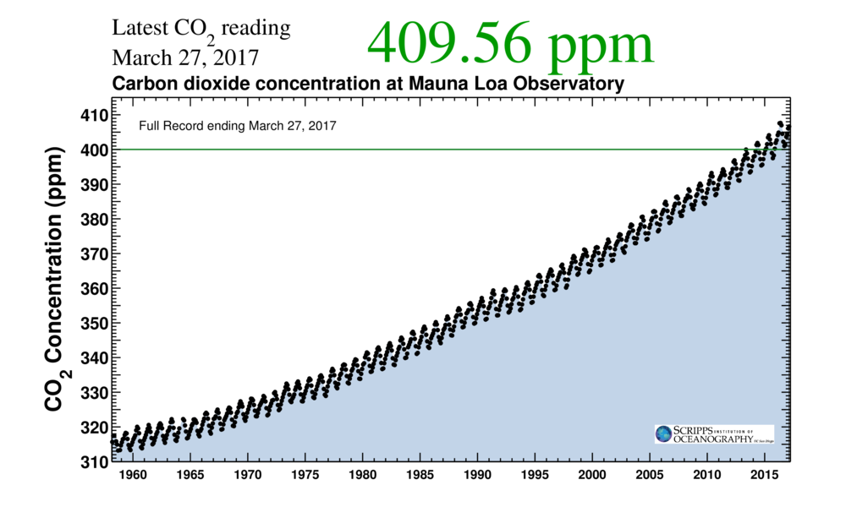

Slide 3
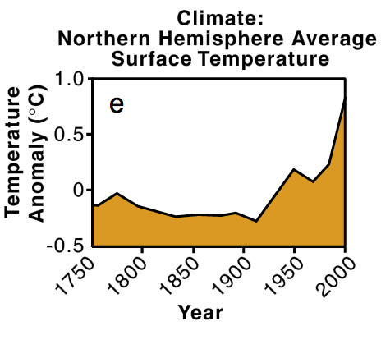

Slide 4
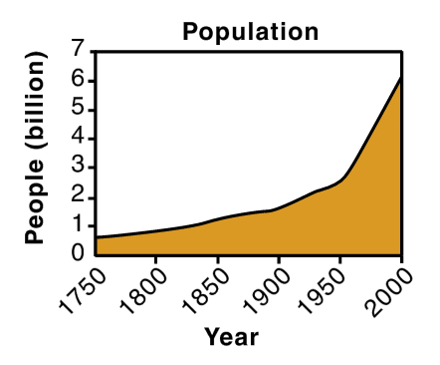
A billion people are being added to this planet every 12 years.

Slide 5
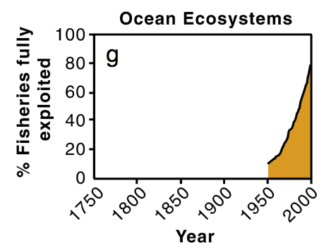

Slide 6
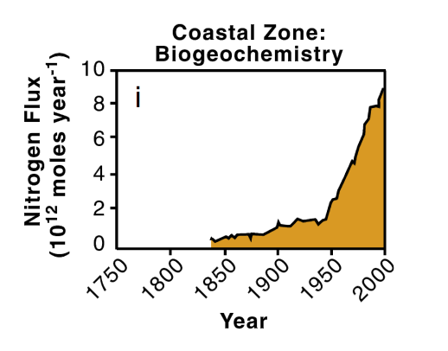

Slide 7
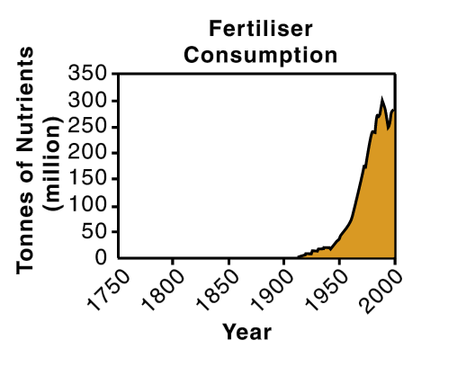

Slide 8
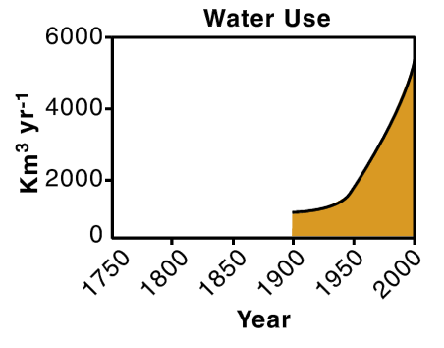

Slide 9
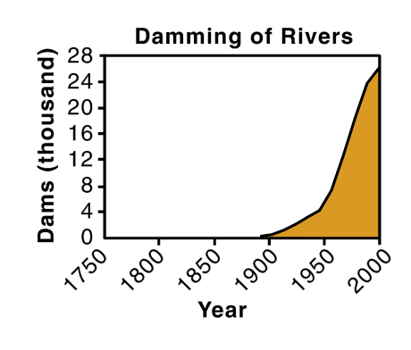

Slide 10
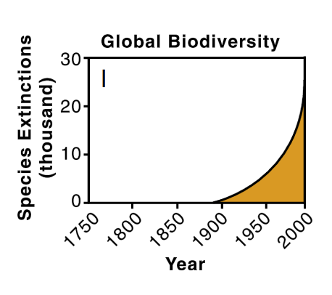

Slide 11
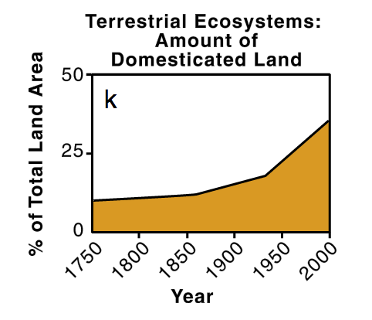

Slide 12
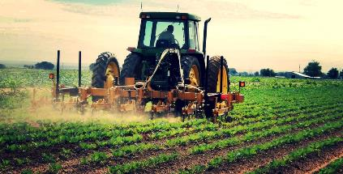
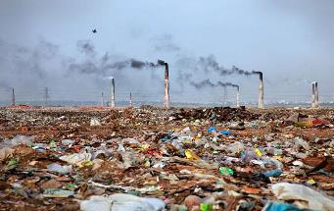
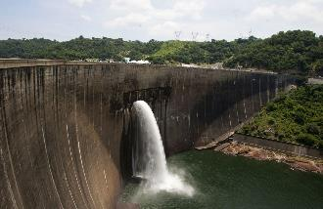
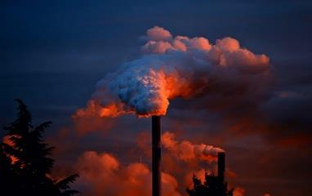
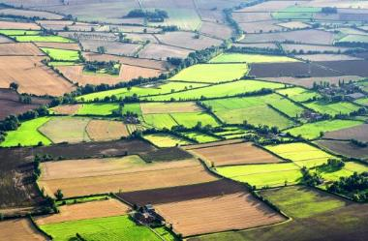
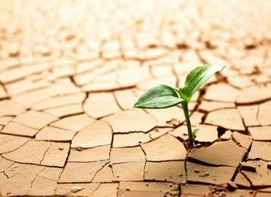
What are we going to do about this?

Slide 14
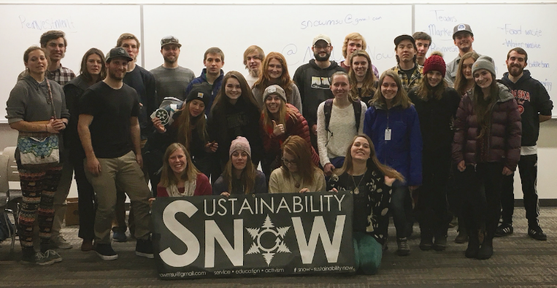

Slide 15
Task Forces

Slide 16
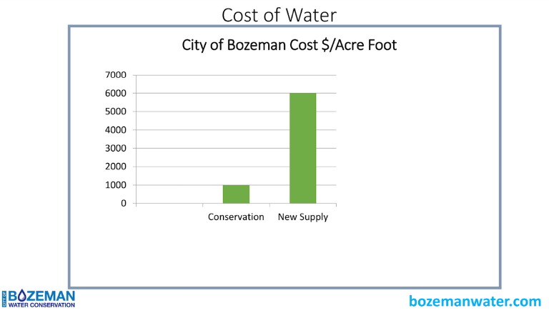
Water Use

Slide 17
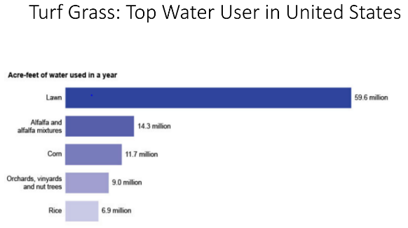
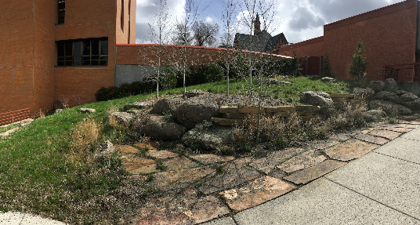
Sustainable Landscapes

Slide 18
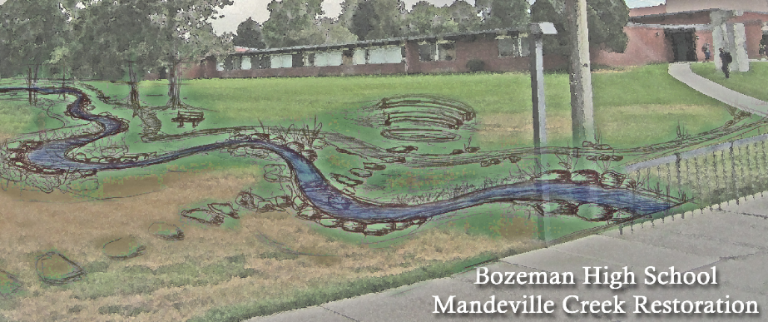
Mandeville Creek Restoration
Photo: http://bhscreek.org/2014/07/16/volunteers-to-bring-new-life-to-bozeman-highs-mandeville-creek/

Slide 19
Political Action
Collected Solar Signatures
Provided education on ASMSU’s election process
Pass Resolutions through ASMSU
Attended various rallies in Helena
Letter Writing Parties
State and Local Representatives

Slide 20
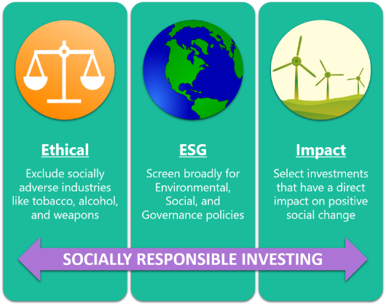
Reinvestment Campaign

Slide 21
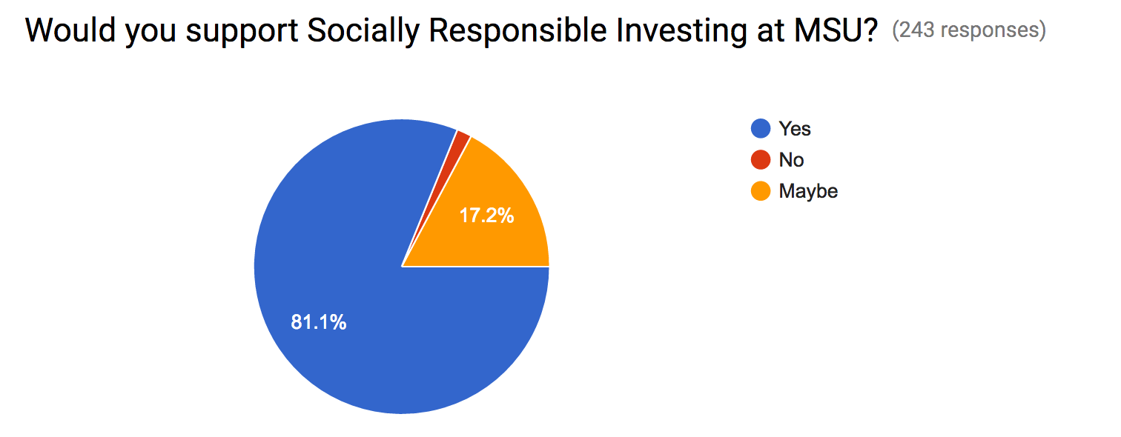

Slide 22
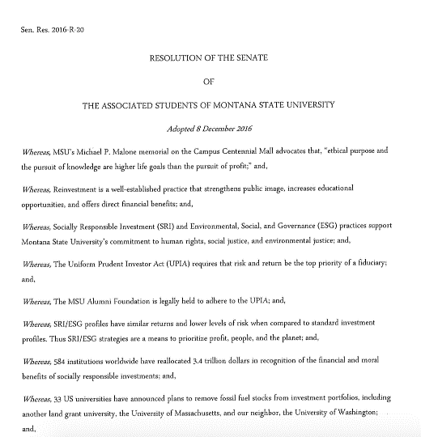
Notes:
Student support, alumni foundation are a separate entity

Slide 23
Notes:
Right now whats legal, higher standard then just whats legal.

Slide 24
Food Waste
Fall 2014 the SFBS Capstone class did an audit:
Measure post consumer food waste in Miller Dining Hall.
If it isn’t measured, it isn’t monitored!
Notes:
Sustainable Food and Bioenergy Systems

Slide 25
Food waste costs $12.20 per week per student
If each freshman wastes this much food per week that’s $42,000 per week or $640,000 per semester!
Notes:
$$ talks

Slide 26
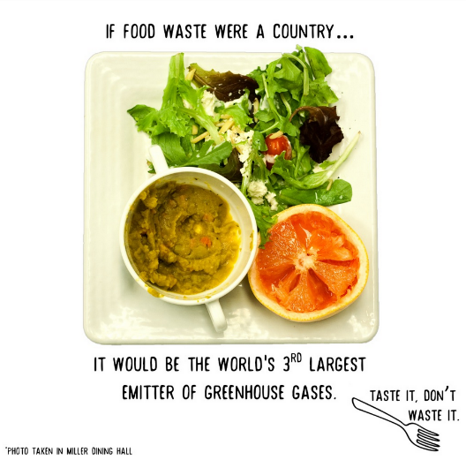
Education
Notes:
Primarily a post consume problem, really get the social pressure to decrease food waste. TV monitors, and window clings

Slide 27
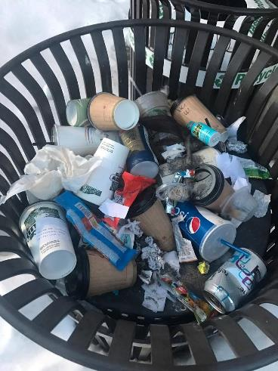
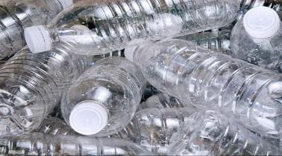
Water Bottle Ban
Have you ever thought about waste “volume” ?
Who would be affected by the ban (Food Services, Concessions etc.)?
Discussion - Communication - Research
Maximize the use of reusable water bottles on campus and make it easy to fill up a water bottles
Notes:
Reach out to EJ on sheet.

Slide 28
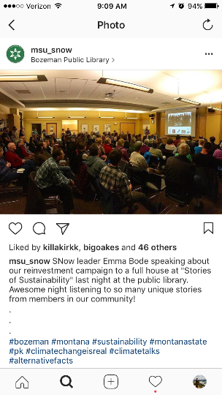
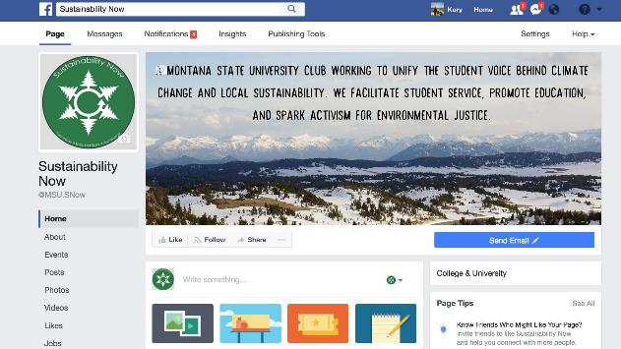
Social Media

Slide 29
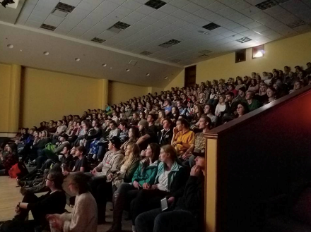
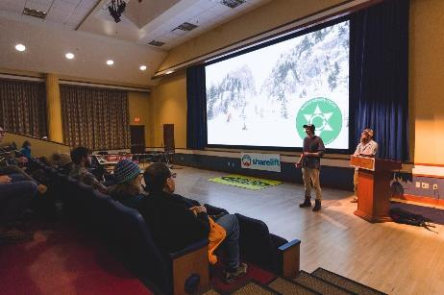
Events
Share Lift event in February with POW athlete KT Miller
“Before the Flood” - Premiere

Slide 30
Climate Communications
Democrats
Republicans
Pro-Life vs. Pro-Choice
LGBT Community
Students Against Sexual Assault
SNow members
How can you communicate with people you disagree with?
Notes:
Peacefully.

Slide 31
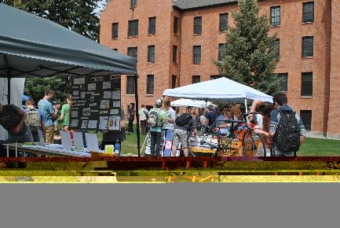
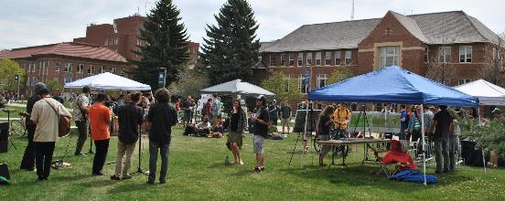
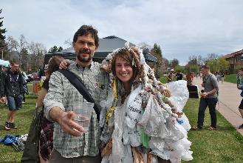
Coming up!
Sustainabilabash
Friday, April 21st from 11 - 2
Join us!

Slide 32
Notes:
Bold political leaders

Slide 33
Questions?
Want in on the fun?
Facebook: @MSU.SNow
Instagram: @msu_snow
Send us an email!
snowmsu@gmail.com

Slide 34
Sources
Global Change Figures: Steffan, W., A Sanderson, P.D. Tyson, J. Jager. Matson, B. Moore III, F. Oldfield, K. Richardson, H.-J. Schellnuber, B.L. Turner II, and R.J. Wasson. 2004. Global change and the Earth System: A Planet Under Pressure. The IGBP Book Series. Berlin: Springer-Verlag.

