Slide 1
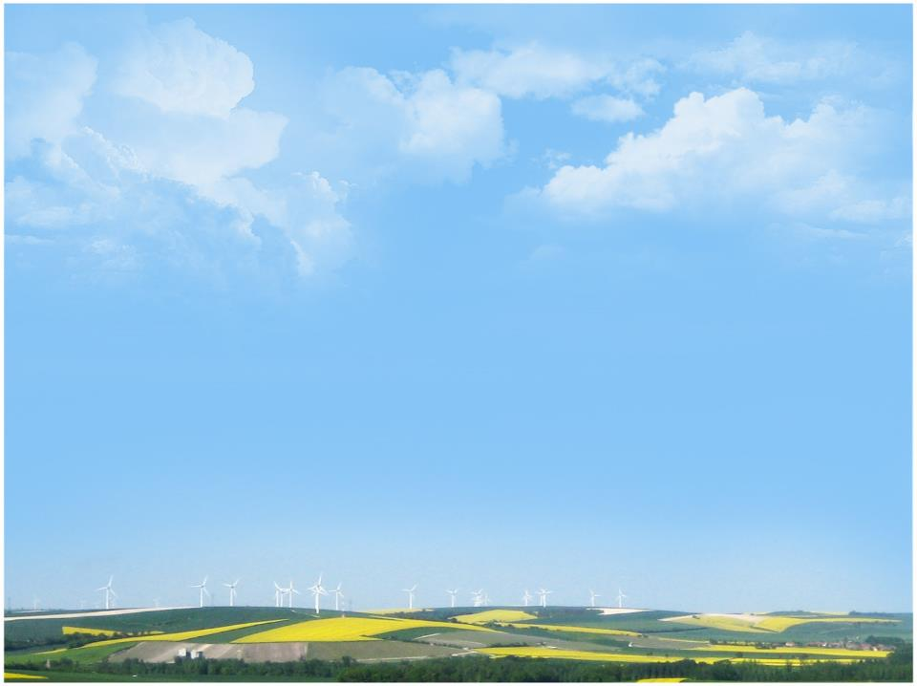
Planting instead of fallowing increases the likelihood of rain in
Montana agroecosystems
Paul C. Stoy^{1*} , Tobias Gerken¹, Gabriel Bromley¹
¹Montana State University
* waferx.montana.edu
bit.ly/StoyGScholar
paul.stoy@montana.edu

Slide 2
Acknowledgements
Funding
NSF EPSCoR Track-2 OIA 1632810
NSF DEB (CAREER) 1552976
USDA NIFA Hatch 228396
MT Wheat & Barley Committee
Colleagues
Meghann Jarchow
David Swanson
Ben Rashford
Selena Ahmed
Brad Bauer
Jack Brookshire
Brent Peyton
Perry Miller
Suzi Taylor
Angela Tang
Elizabeth Vick
David Wood
Roger Coupal
Robert Godby
Mark Dixon
Jacob Kerby
Shannon Albeke
Terry Sohl
John Ritten
Alisa Royem
Crista Straub
Tilden Meyers
..and many more

Slide 3

Montana is warming at the same rate as the rest of the world

Slide 4
Montana’s air is getting more humid. Why?

Slide 5
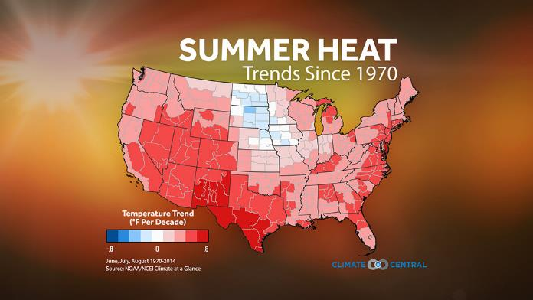
Are parts of Montana cooling in summer?

Slide 6
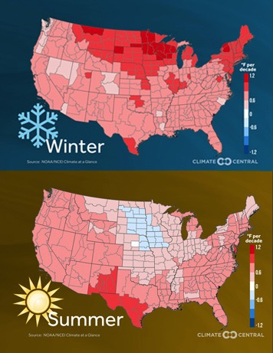
If so, why only during summer?

Slide 7
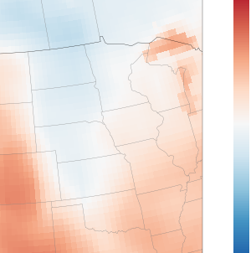
Is there a large country to our north?
. Fort Peck (US-FPe)
. Judith Basin (US-MJ1,2)
MJJ mean temperature trend, 1970s-present, ECMWF-ERA-20 reanalysis.
Figure credit: Gabriel Bromley

Slide 8
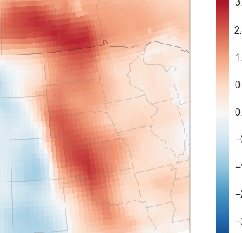
Decreases in temperature coincide with increases in humidity
. Fort Peck (US-FPe)
. Judith Basin (US-MJ1,2)
MJJ mean RH trend, 1970s-present, ECMWF-ERA-20 reanalysis.
Figure credit: Gabriel Bromley

Slide 9
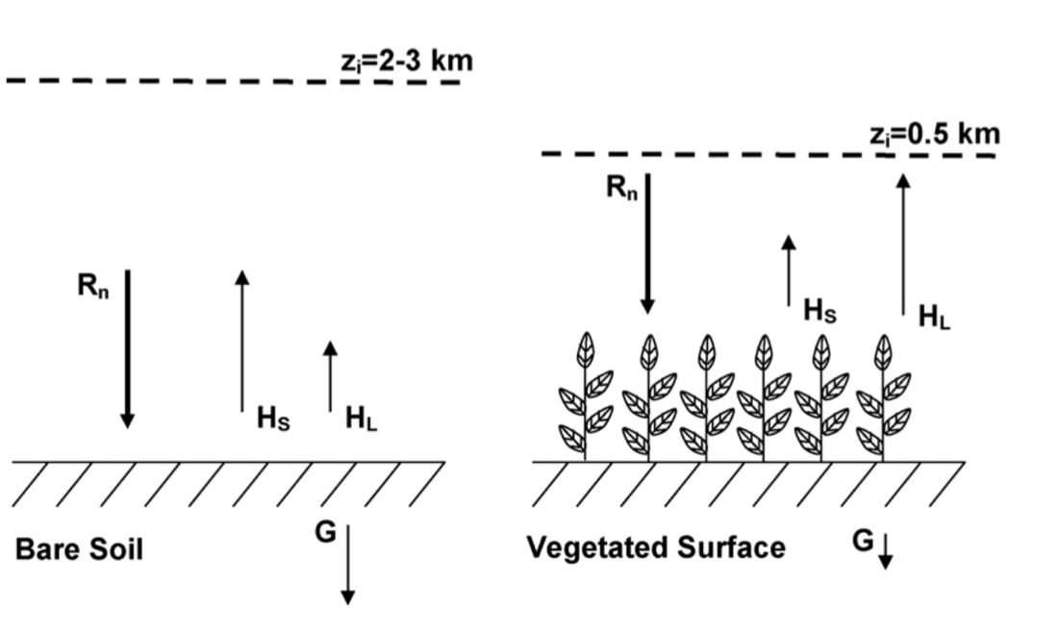
Why is it cooler with more rain in summer?
In the Canadian Prairies over the past 4 decades:
Summer Tmax: - 1 °C trend
Precip: + 10 mm/decade trend
-6 W m⁻² summer forcing!
Anthropogenic warming +2.5 W m⁻²
Gameda et al., (2007)
Betts et al. (2013 a,b)

Slide 10
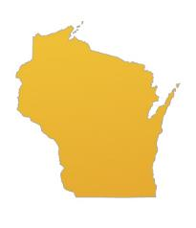
The scale of fallow reduction
14 Mha

Slide 11
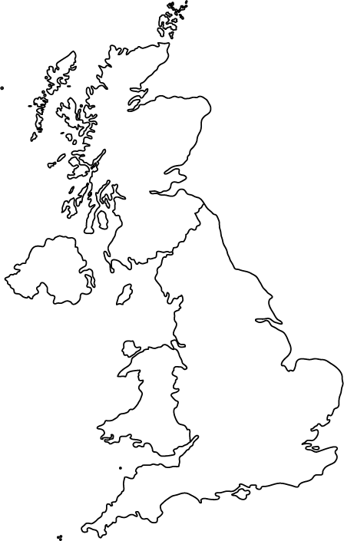
The scale of fallow reduction, ca. 23 Mha
Nearly the size of
Wyoming
Oregon
Chihuahua

Slide 12
Shifts away from summer fallow increase evapotranspiration
and decrease sensible heat flux (thermals)
Evapotranspiration
Sensible Heat
Vick, Stoy, Tang & Gerken (2016)

Slide 13
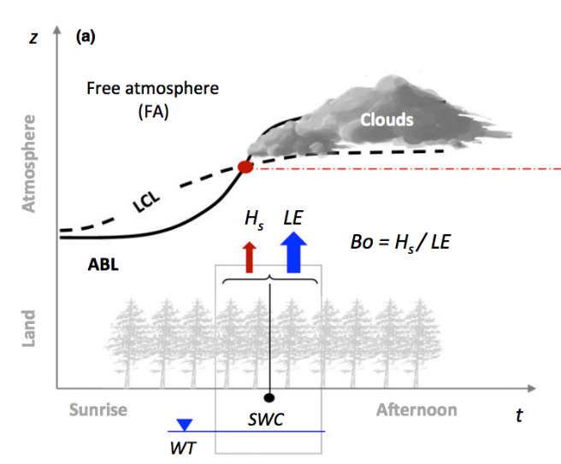
ABL – LCL crossing is a ‘necessary but not sufficient’ condition for convective precipitation
Manoli et al. (2016)
See also:
Findell and Eltahir (2003a,b), Juang et al. (2007a,b), Koenings et al. (2010),
Porporato (2009) and many more

Slide 14
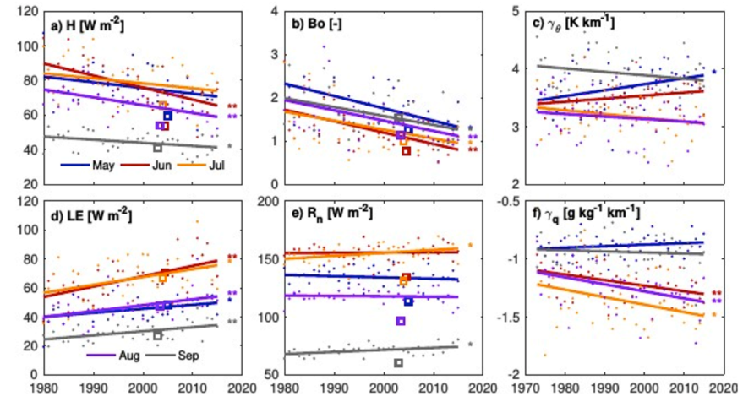
Large decadal changes in surface and atmospheric conditions
MERRA for Fort Peck, MT. Figure credit: Tobias Gerken

Slide 15
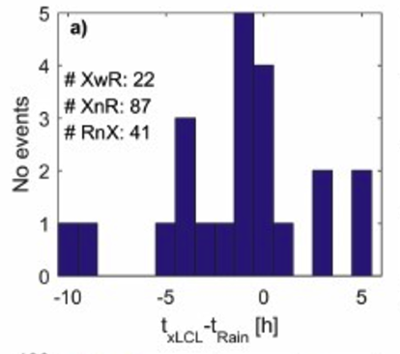
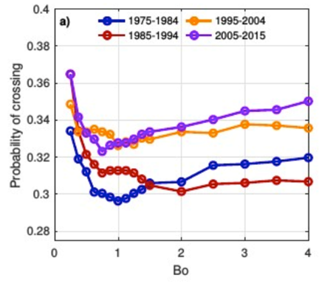
Modeled ABL / LCL crossings can accurately predict precipitation
Convective likelihood is now 10% greater in NE Montana
(and increasingly sensitive to further decreases in the Bowen ratio)
Figure credit: Tobias Gerken

Slide 16
Moving forward
A possible ‘win-win-win’ situation for soil C
conservation, regional climate, and farm-scale
economics in Montana.

Slide 17
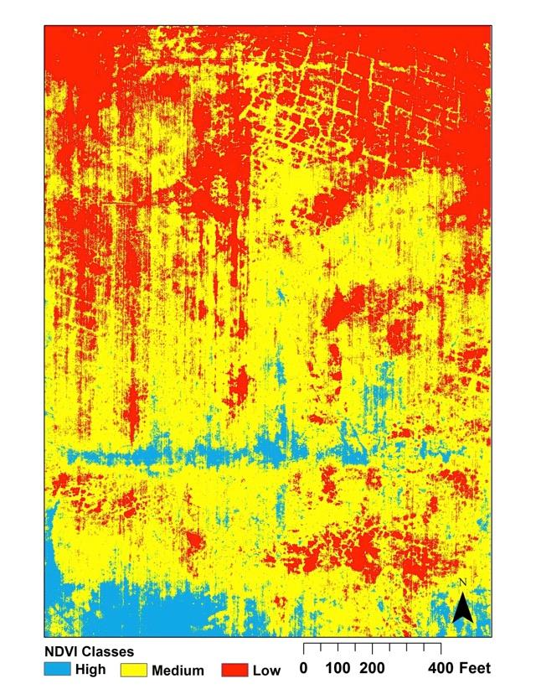
Making the whole field count: Precision agriculture
Large within-field NDVI variability
US-MSR
X
NDVI tracks wheat yield and protein
PRI tracks C flux even better than NDVI
Figure credit: Aaron Wipf

Slide 18
Plants are sensitive to atmospheric dryness
This happens to be from FLUXNET site AT-Neu

Slide 19
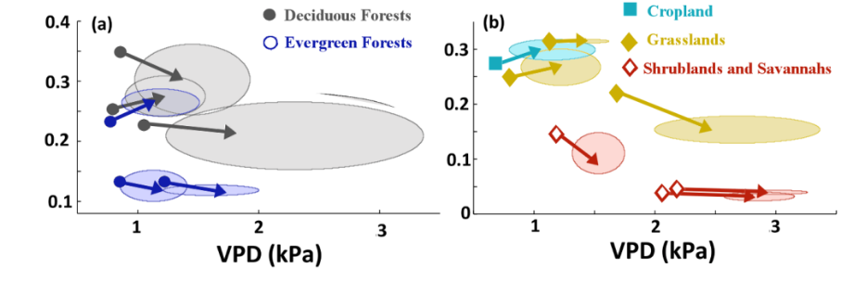
Climate change will increase the importance of VPD to carbon and water fluxes
Soil moisture changes are less certain
Soil Moisture
Novick, Ficklin, Stoy, Williams et al. (2016) Nature Climate Change
(mean of 10 GCMs for 38 FLUXNET sites in North America)

Slide 20
The largest fallow changes are in Saskatchewan…

Slide 21
…and North Dakota.
(2)
(3)
(1)
Is this a win-win-win scenario for regional climate,
soil conservation, and income?

Slide 22
Global trends in specific humidity (SH), 1948-2008

Slide 23
Climate change will increase the importance of VPD on carbon and water fluxes in terrestrial ecosystems
Soil moisture changes are less certain
Soil Moisture
Novick, Ficklin, Stoy et al. (2016) Nature Climate Change
(mean of 10 GCMs for 38 FLUXNET sites in North America)

